Slide 1
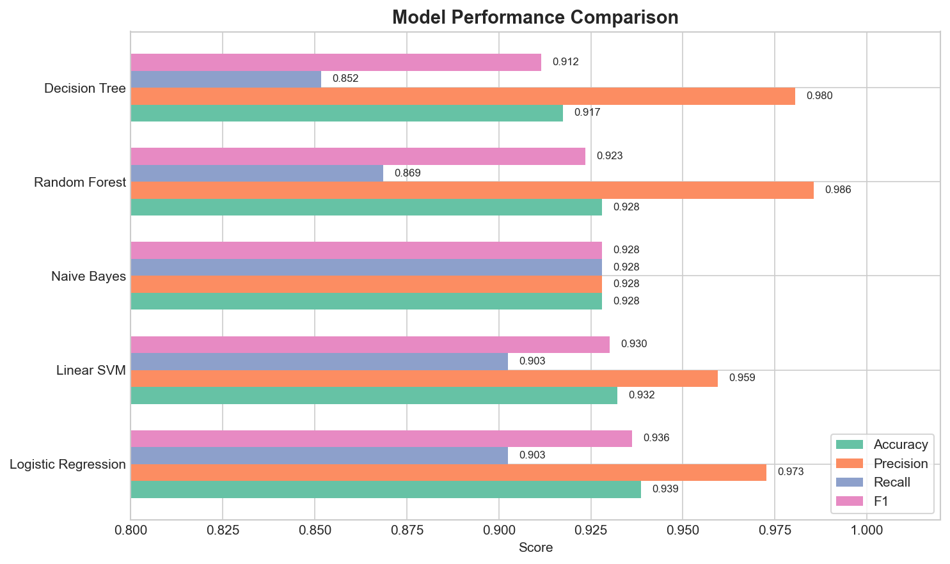
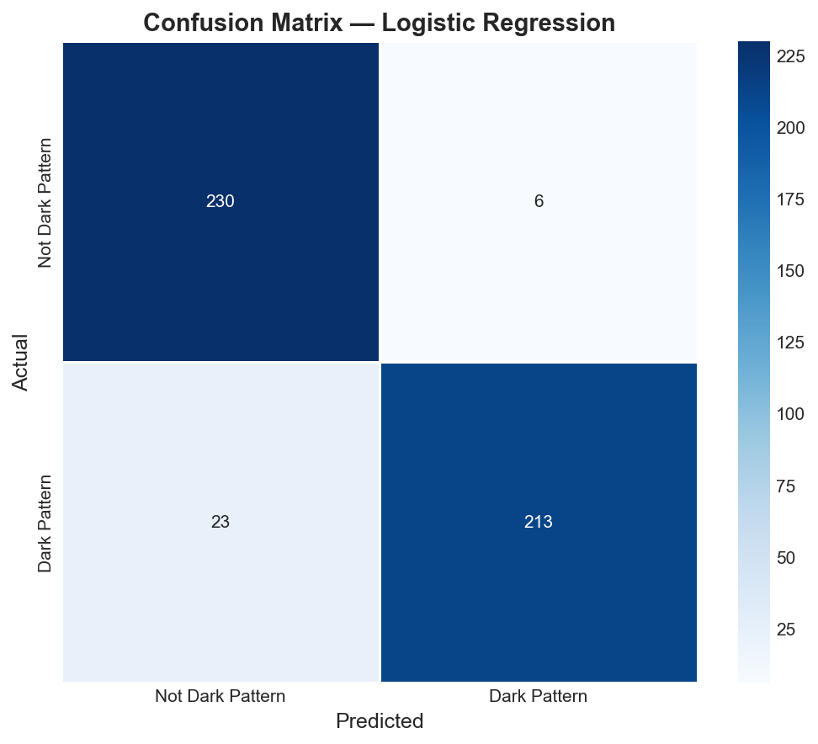
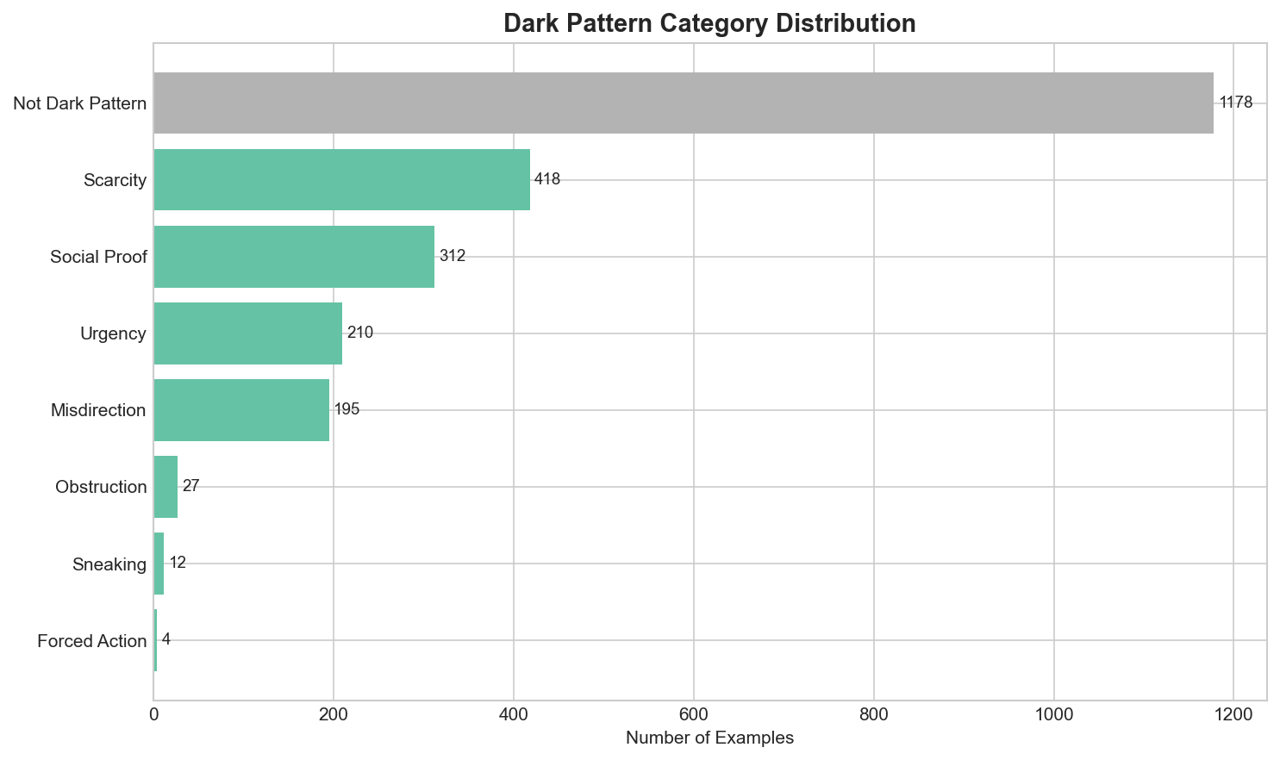
Dark Pattern Recognition
AI4ALL Ignite Team 20C | Supervised NLP for E-Commerce Text
Research Question
Can supervised text classifiers detect dark-pattern language, and what are the limits of text-first detection?
Data
Primary baseline: 2,356 Krish Uppal snippets, balanced 50/50. Secondary sources: Devitachi + Akash Nath.
Model
TF-IDF + Logistic Regression. Compared against Linear SVM, Naive Bayes, Decision Tree, and Random Forest.
Result
Best primary model: 93.9% accuracy, 0.936 F1.
Demo
Streamlit app for manual text. Playwright scanner for visible webpage text. Demo safeguards reduce discount/product-title false positives.
Responsible AI
False positives can unfairly flag businesses; false negatives can miss harm. The model is a review aid, not a final accusation.
Future Work
Hard-negative mining, TF-IDF tuning, threshold tuning, OCR, visual layout features, and UX-flow testing.
GitHub: https://github.com/RadRebelSam/ai4all-20c-darkpatterns | Page: https://radrebelsam.github.io/ai4all-20c-darkpatterns/

